Slide 1

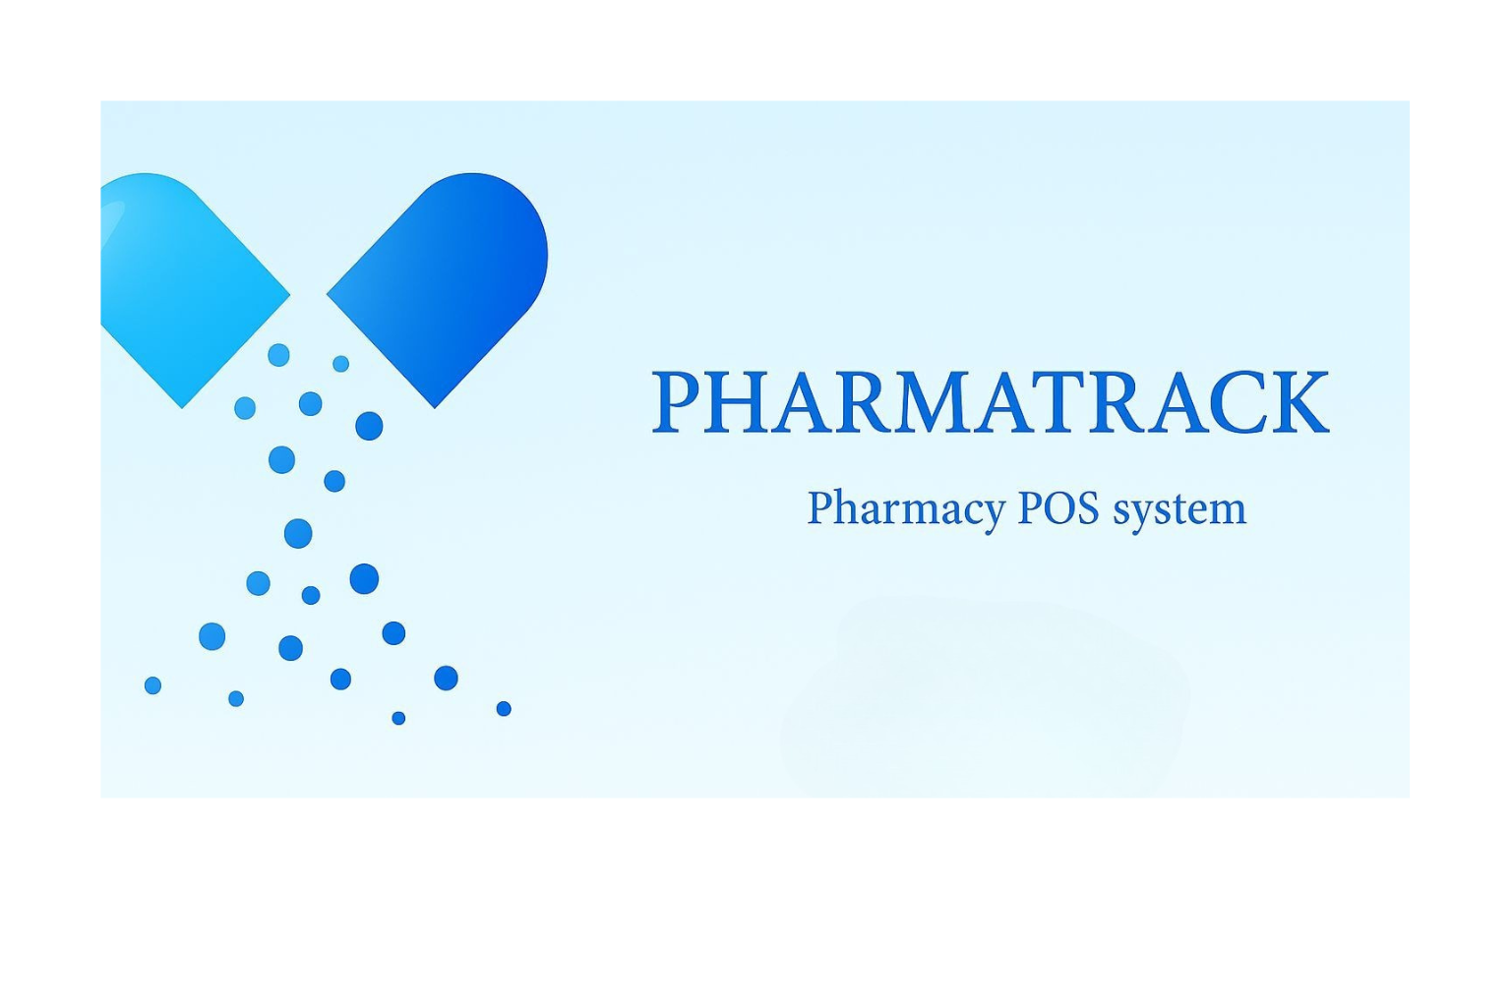

PHARMATRACK: A PHARMACY POINT OF SALE (POS) SYSTEM
Project Defense
An approach to optimize Pharmacy Inventory & Sales
Presented By
Sabu Bhuju (535/078)
Kripa Banskota (521/078)
Smriti Basu (541/078)
Under the Supervision of
Mr. Bhim Bdr. Rawat

Slide 2
Problem Statement
Introduction
2
Objective of the system
1
3
Development Methodology
Conclusion & Future Vision
4
10
CONTENT
OVERVIEW
Functional Requirement
5
Research
Results
9
6
System Architecture
8
04
7
Core Algorithm
Database & User workflows

Slide 3
Introduction
Nepal’s pharmacies still rely on manual record-keeping.
Manual systems lead to errors, slow data retrieval, and poor inventory tracking.
PharmaTrack is a web-based POS system that digitizes stock, sales, expiry alerts & reporting.
Includes fuzzy search, heuristic priority algorithm, and digital billing.
Aims to improve efficiency and reduce human error.

Slide 4
Problem Statement
Problem 1
Manual pharmacy operations increase risk of expired stock, wrong billing, and data inaccuracy.
Problem 2
Difficult to track stock levels, expiry dates, and daily sales manually.
Problem 3
Searching medicines with partial names is slow and inefficient.
Problem 4
No automated alerts or digital reports.

Slide 5




Objective of the system
Implement stock tracking, low-stock & expiry alerts, and automated billing.
Ensure data accuracy with real-time inventory and sales updates.
Create a simple and user-friendly interface usable by non-technical staff.
Design a scalable architecture to support future upgrades.

Slide 6
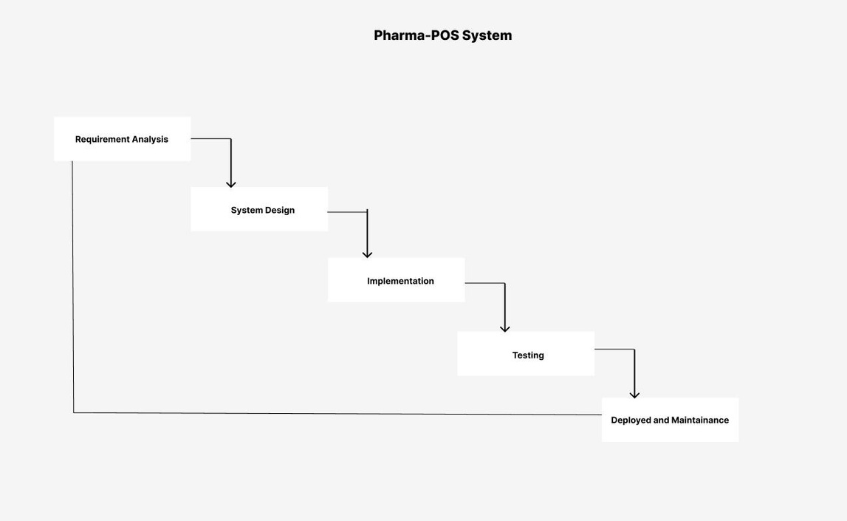
Development Methodology
PharmaTrack uses the Waterfall Model with a clear, step-by-step process where each phase is finished before the next, ensuring proper documentation, minimal overlap, and reliable testing.

Slide 7




Functional Requirement
User authentication
(login/register)
Expiry alert system
Stock & inventory
management
Transaction history &
reporting
Billing & receipt
generation
Dashboard analytics

Slide 8
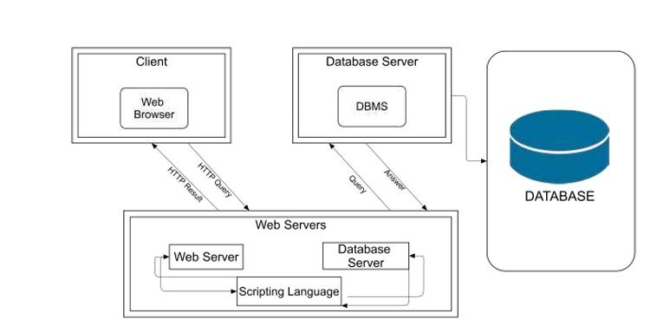
System Architecture
Follows 3-tier client-server architecture:
Client (React.js frontend) – UI, forms, dashboard
Middleware (PHP backend) – business logic & APIs
Database (MySQL) – users, products, sales, transactions
Ensures modularity, scalability, and secure data operations.
No direct communication between UI and database.

Slide 9
Core Algorithm
Heuristic Priority Algorithm
Monitor products and prioritize alerts based on urgency.
Highlight items with low stock or nearing/expired dates.
Key Approaches:
Score calculation rules:
Low stock (≤20 units) → +50 points
Expired products → +100 points
Expiring within 14 days → +80 points
Greedy Selection:
Sort products by heuristic priority score (descending)
Highest-priority items (expired, expiring soon, very low
stock) appear first
Only positive-score products are included in alerts

Slide 10
Fuzzy Search Algorithm
Enable users to find products even with partial matches or typos.
Matches across product name, category, and generic name.
Key Approaches:
Field Selection
Consider multiple product fields: name, category, generic name.
Only fields whose first 3 letters match the search term are evaluated.
Similarity Scoring
Use Levenshtein Distance to measure edits required to match search term.
Normalize score between 0 and 1.
Take the highest similarity score among all fields per product.

Slide 11
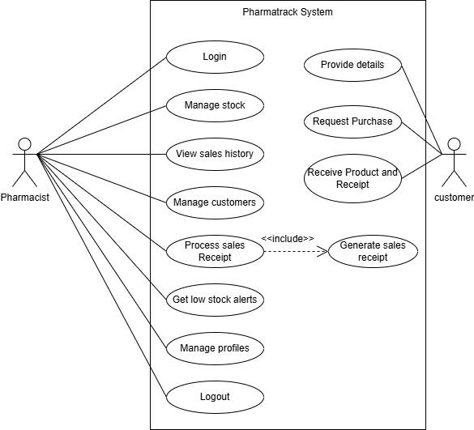
Use-case Diagram
Define system functionality
Clarify roles
Visualize interactions
Support requirement analysis
Identify included use cases
Guide system design

Slide 12
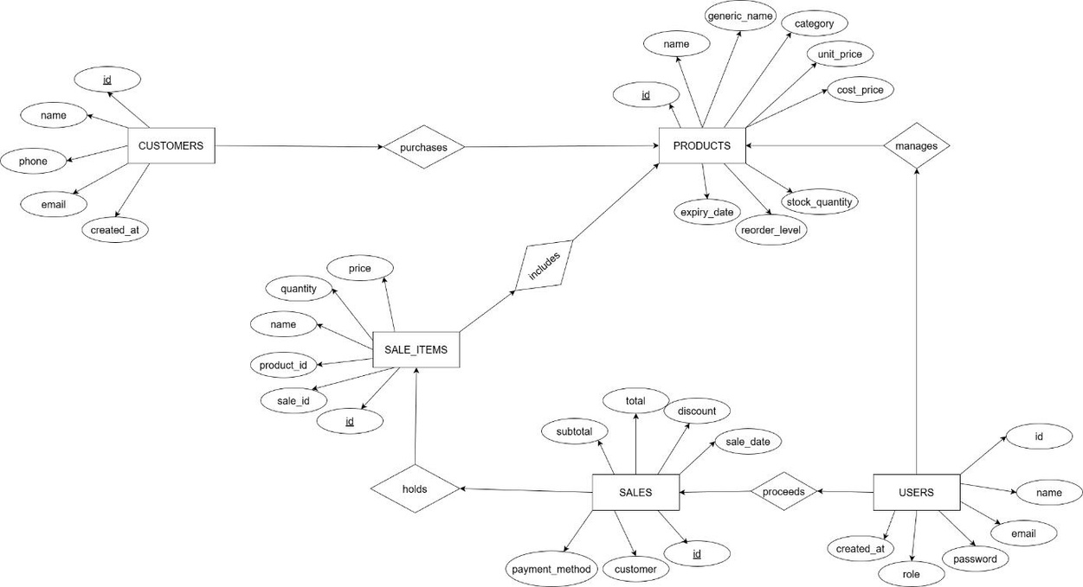
Database Design
customers, products, users, sales, and sale_items are interconnected. Customers make purchases (Sales), which are handled by Users and contain multiple sale_i tems linked to Products. Each entity tracks relevant details like pricing, stock, and timestamps, enabling efficient sales and inventory management.

Slide 13
Research Results
Fuzzy search significantly reduces search time and improves accuracy.
Stock alert system successfully detects:
Expired medicines
Near-expiry items
Low stock
Billing module updates stock in real-time without errors.
Dashboard analytics accurately represent sales statistics and stock levels.
The system is stable, responsive, and suitable for small–medium pharmacies.

Slide 14
Conclusion & Future Vision
PharmaTrack successfully digitizes pharmacy operations, ensuring secure and accurate inventory and sales management. Its user-friendly design enables easy adoption, and it fulfills all goals of building a reliable, intelligent POS system
Current Success
PharmaTrack streamlines pharmacy operations with accurate inventory and sales management, reducing errors and improving efficiency.
Future Enhancements
Mobile app for remote access
Multi-branch and wholesaler support
Barcode scanning and AI-based restocking
Advanced analytics and reporting tools
Impact
Higher productivity and fewer manual mistakes
Better medicine availability and user satisfaction
Scalable for hospitals, clinics, and retail chains

Slide 15
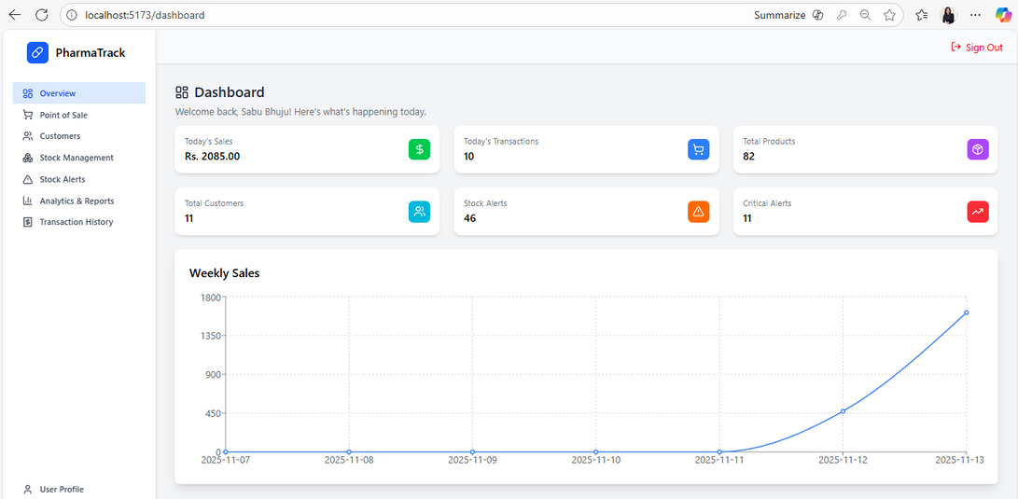
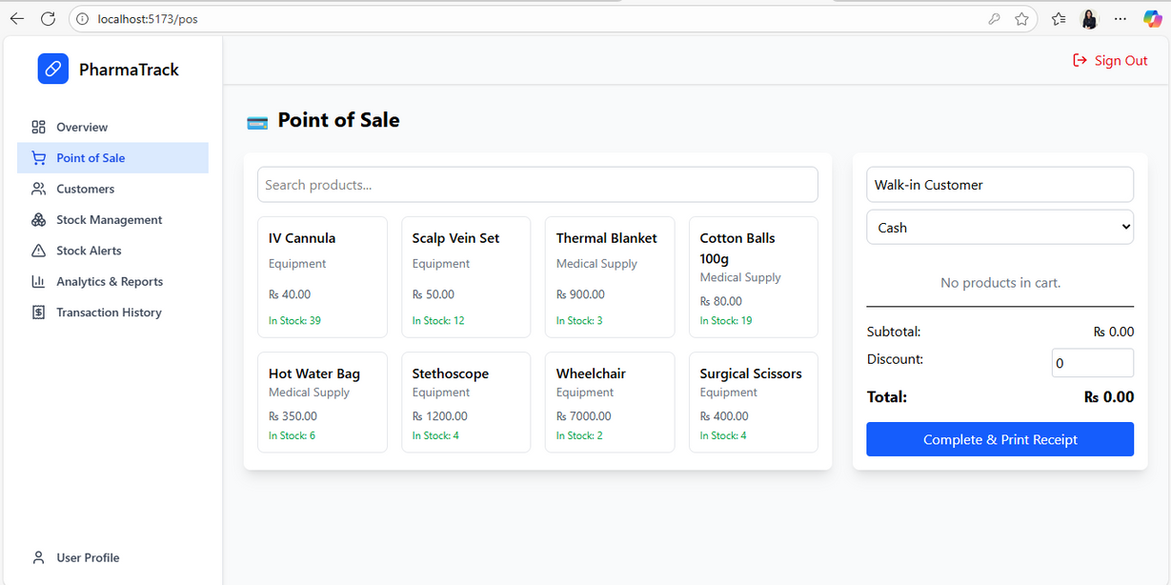
System Screenshot

Slide 16
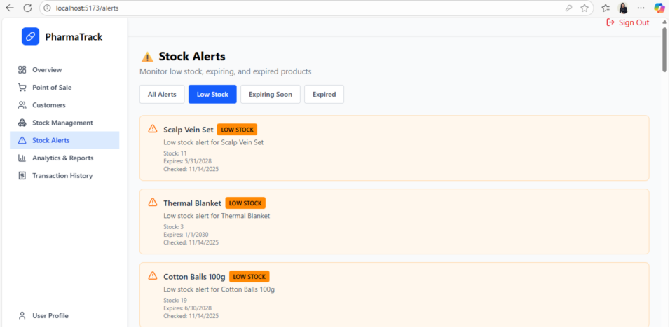
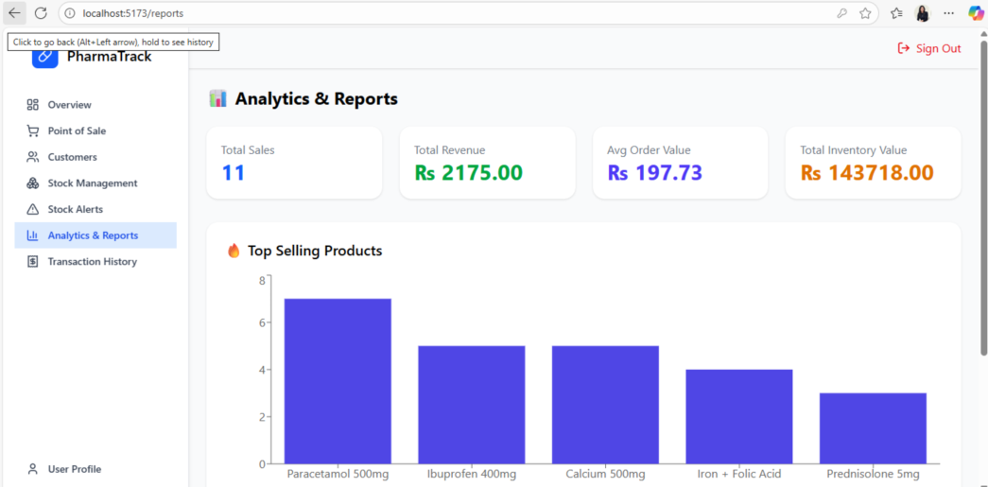
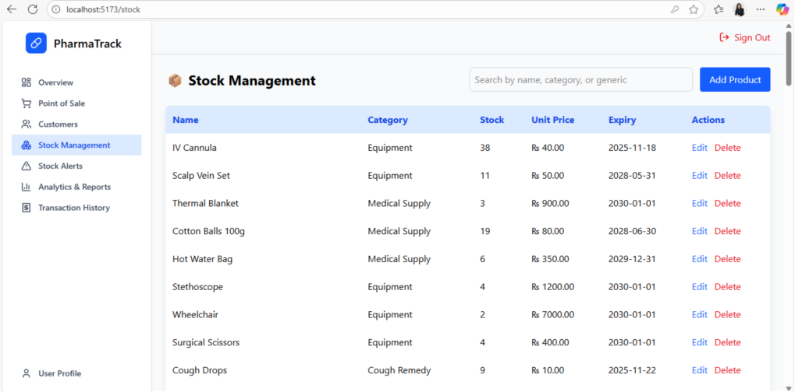
System Screenshot

Slide 17
Thank you

